Slide 1
The Office for Students
8 March 2018
Notes:
Diverse institutions in terms of size and missions
Fully autonomous in teaching, admissions and management
Research funding is competitive and concentrated
Teaching is funded by fees and government student loans
Evolution of a collaborative approach to policy and regulation

Slide 2
The HERA
A regulator focused on choice, competition, value for money and mobility
Explicit protection for autonomy and duty to be proportionate
Voluntary register with general and specific conditions
DAPs and university title
Scheme to rate the quality and standards of providers
Strategic focus on outcomes and risk based regulation
Notes:
Not funding

Slide 3






A regulator
Notes:
Protect institutional autonomy
Promote quality and choice for students
Encourage competition and collaboration in the interests of students and employers
Promote value for money
Promote equality of opportunity
Establish a registration scheme (quality and sustainability)
Power to grant (and revoke) DAPs and UT (in consultation)
Provision for ratings of teaching and variation of fee caps (TEF)
Work with designated bodies for quality assessment and statistics
Require ‘access agreements’ and ‘student protection’ plans
Support ‘credit transfer’ & ‘accelerated degrees’

Slide 4
Regulatory strategy
Baseline conditions to protect student and public interest
Targeted interventions to advance specified student and public interests
Freedom for institutions to determine their own path
Leadership on best practice, sustainability and the future role and shape of the sector

Slide 5
The regulatory framework
All students from all backgrounds, and with the ability and desire to undertake higher education:
Are supported to access, succeed in, and progress from higher education
Receive a high quality academic experience, and their interests are protected while they study or in the event of provider, campus or course closure
Are able to progress into employment or further study, and their qualifications hold their value over time
Receive value for money.

Slide 6
Conditions of registration
Access and participation for students from all backgrounds (2)
Quality reliable standards and positive outcomes for students (6)
Protecting the interests of all students (3)
Financial sustainability
Good governance (5)
Information for students (4)
Accountability for fees and funding (3)
Notes:
Access and participation (A1 & 2)
Transparency (A3)
Quality and standards (B1-3 & C1 & 2)
Financial viability and sustainability (D)
Management and governance (E1 & 2)
Senior staff pay transparency (E3)
Student contracts (E4)
Student protection plans (F)
Student complaints (G)
Student transfer arrangements (H)
Notification of changes
Provision of information
Mandatpory fee limit
Facilitate electoral registration
Pay OfS fees
Complying with T&Cs of funding
Accountability
TEF
Senior pay in accounts mechanism but still linked to the reg framework
tweak in the student interests - no longer as customers.
Application deadlines not guillotine
Applications for OfS regulation from 1st august 2019
HEFCE regs continue to apply for 2018/19 - more detailed guidance soon
Nicola did menion co-regulation

Slide 7
Student engagement
Broader definition of protecting student interests
Student engagement included in public interest governance conditions
Individual and collective student engagement in new quality code

Slide 8
Compliance
Access and participation for students from all backgrounds (2)
Quality reliable standards and positive outcomes for students (6)
Protecting the interests of all students (3)
Financial sustainability
Good governance (5)
Information for students (4)
Accountability for fees and funding (3)
Stance and credibility of judgement

Slide 9
Risk based regulation
Lead indicators
Initial conditions – assessment of institutional governance and risks
Enhanced monitoring
Ongoing conditions B
Specific conditions
Failure!

Slide 10
Organisational challenges
For HEFCE/ OfS
Transition to the OfS register
Establishing ‘independence’
Statutory shift from funder to students
Operationalising risk in diverse sector
For sector and institutions
New definition for ‘the sector’
Different relationship to OfS
Regulatory creep and burden
For student representatives
Establishing voice with the OfS
Role in student protection
Coherence of UK wide system
Co-regulatory system
Expanded but defined powers
Role in quality and standards
Transition to the OfS register
Notes:
Protect students, and tax-payers, from poor quality, transient or negligent providers that do not place high-quality education at the heart of their mission and operation.
Give explicit consideration to the risks to institutional diversity and autonomy in recognition of the value to students and the statutory duty on the OfS.
Clarify appetite for risk and how it will define proportionate interventions so that the OfS, sector and institutions can accurately assess the risks and burden.
Work with sector partners to revise the co-regulatory architecture embedded by the HERA to enable confidence in judgements, foster ethical behavior and maintain UK system.
Ensure the register remains a focused regulatory baseline and clarify the role of market and voluntary mechanisms for achieving policy objectives.
Introduce a voluntary stage prior to introduction of blanket general conditions of registration.
Revisit the proposals on freedom of speech that are outside the OfS's statutory remit and are not based on the HERA or the 1986 Act.

Slide 11
Getting registered
Governance statement
Student protection plan
Statement on consumer protection
Access and participation plan
HEFCE/OfS will use Existing APR and FSMG

Slide 12
The TEF
Adopted as the scheme to rate the quality and standards of provision
Condition of registration
Innovation and student outcomes agenda
Independent review 2018/19
Subject level ongoing with intention to move to it 2019/20

Slide 13
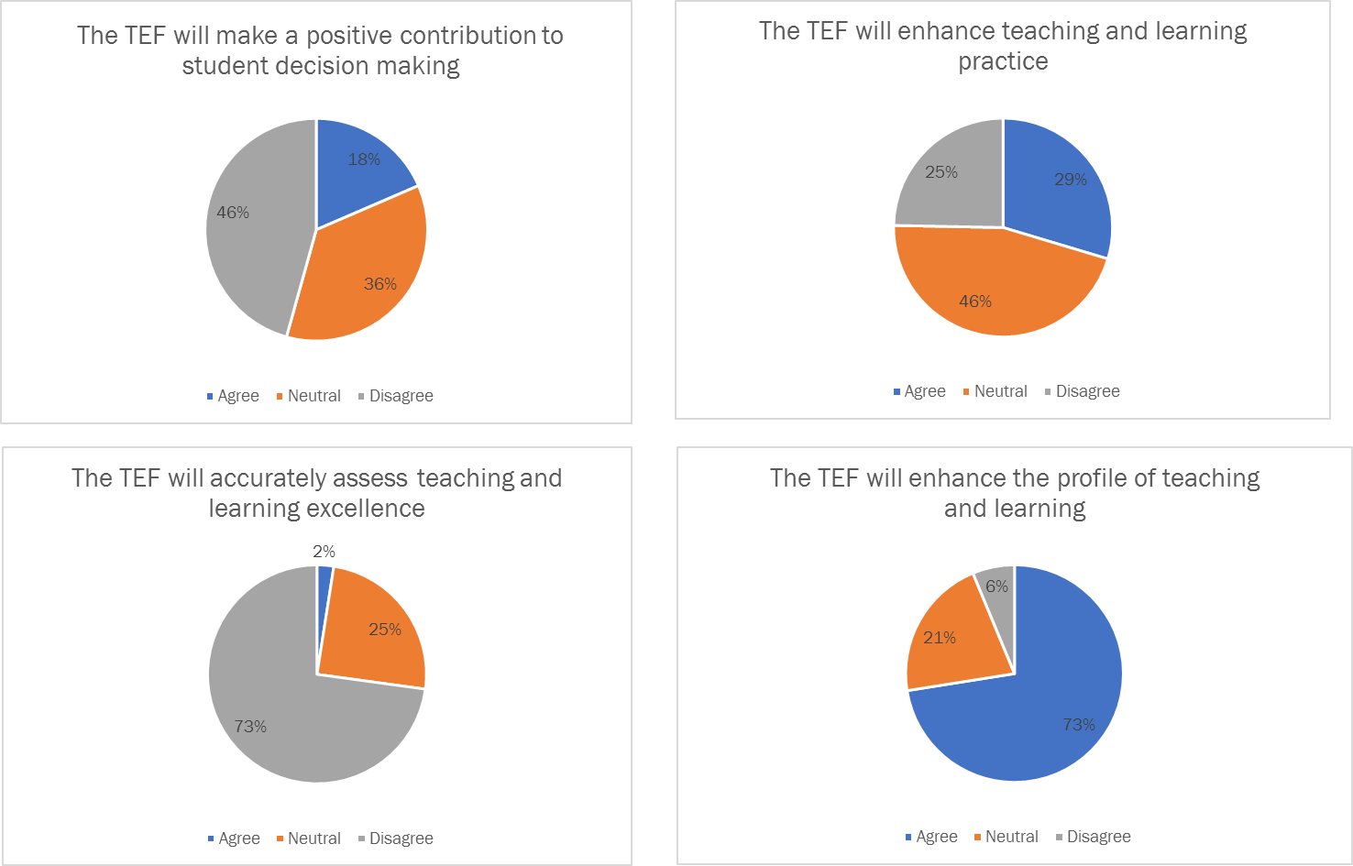
Confidence?

Slide 14
Grade inflation

Slide 15
Medium and longer term
Defining and embedding value for money into the work of the OfS
Data strategy and the development of lead indicators
Market strategy, including student information and future of TEF
Supporting the industrial strategy, skills agenda and innovation
The role of ‘the sector’ in policy and refreshing coregulation
Notes:
Independent review of the impact and operation of the OfS in 2021/22 from perspective of students, institutions and public interest?

Slide 16
Things to think about
Demonstrating impact of teaching and learning
Employability
Value for money in teaching versus wider factors
Innovation versus metrics
Grade inflation and differential outcomes

Slide 17
william.hammonds@universitiesuk.ac.uk

