Slide 1
Update on sector reforms
Heads of Educational Development
2nd December 2016

Slide 2
Changes afoot
Supply side liberalisation
and
Evolving models of public accountability

Slide 3

White paper

Slide 4

Mk 2

Slide 5
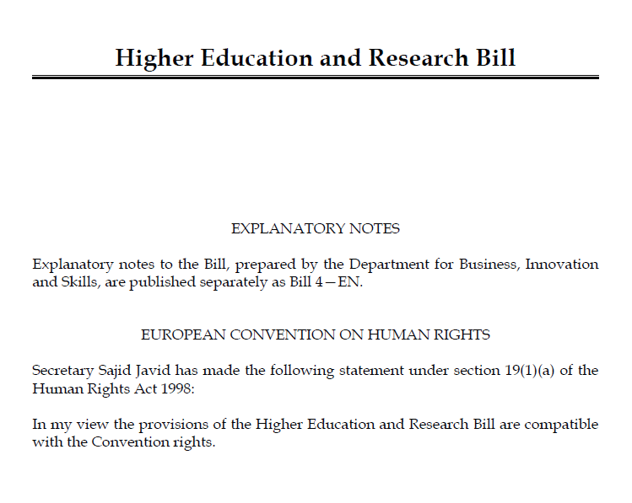
With legislation

Slide 6
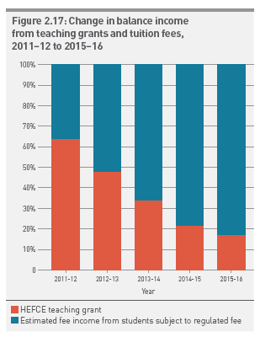
Price ‘transparency’

Slide 7
Supply side liberalisaion
Number of English institutions with large percentage changes in UK acceptances by UCAS cycle year.
Year | #inst.s w +15% | #inst.s w+10% | #inst.s w-5% | #inst.s w-3% | # w. lge change (+15%, -5%) | #w. lge change (+10%, -5%)
2007 | 8 | 34 | 14 | 17 | 22 | 48
2008 | 42 | 62 | 6 | 9 | 48 | 68
2009 | 23 | 34 | 28 | 34 | 51 | 62
2010 | 18 | 22 | 33 | 44 | 51 | 55
2011 | 8 | 21 | 22 | 34 | 30 | 43
2012 | 6 | 9 | 55 | 64 | 61 | 64
2013 | 15 | 32 | 12 | 19 | 27 | 44
2014 | 7 | 25 | 18 | 25 | 25 | 43
2015 | 23 | 38 | 20 | 28 | 43 | 58

Slide 8
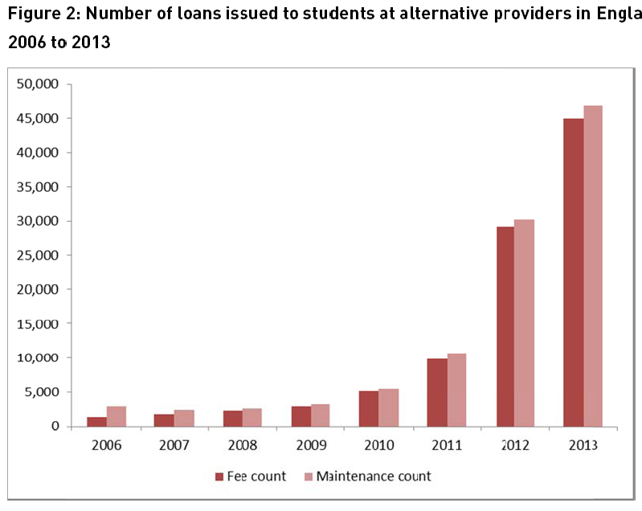
Supply side expansion

Slide 9
University of Phoenix
Online + local within 10 miles of 87 million Americans
No tenured professors – recruited by the class
Marketing – 20% of Apollo group’s $1.3 billion net revenue
Aggressive recruitment of federal aid students – nearly 90% of revenue
Equals 455,600 enrolled students in 2010 (25,000 in 1995)
Notes:
At its peak in 2010, Apollo had 475,000 degree-seeking students and about $4.9 billion in annual revenue. Today, enrollment has fallen to under 200,000 students and revenue is down to about $800 million.
Last year, an Inside Higher Ed analysis of federal records determined that Phoenix received more than $1.7 billion in federal student loans and grants -- the most of any college.
· St Patrick’s International College (parent body: Global University Systems)
· London School of Business & Finance (parent body: Global University Systems)
University of Law Global University Systems
Greenwich School of Management (parent body: Sovereign Capital)
BIMM Sovereign Capital

Slide 10
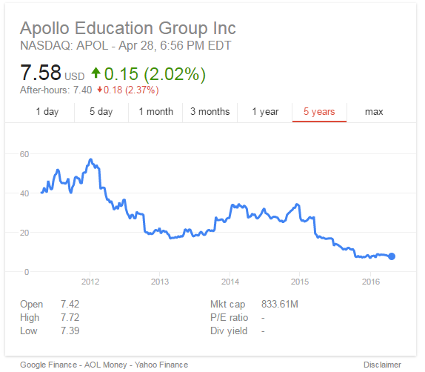
Apollo education group

Slide 11
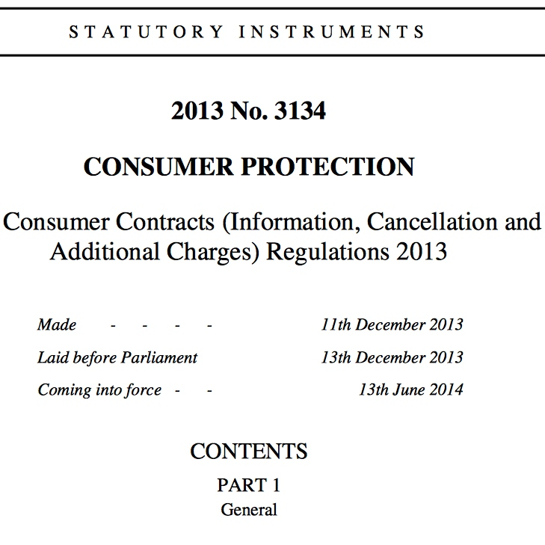
Consumer rights

Slide 12





Office for students

Slide 13
UUK bill priorities
Maintain high entry requirements
Protect sector autonomy through co-regulation
Clarify relationship between standards and quality
Integration with research

Slide 14
Higher Education and Research Bill
Clause(s) | Issue related to
2 | Broad role and remit of the Office for Students
NC 2A | Ability of the OfS to give advice without specific request from the Secretary of State
2, 66 and 69 | Power of the secretary of state to frame guidance (etc) to the OfS ‘by reference to’ courses
13 (23, 27 and Schedule 4) | Registration condition related to ‘quality’ and ‘standards’ of education
15, 16, 18, 21 | Threshold of evidence required by OfS in order to impose sanction
40 | Power of OfS to authorise research degree awarding powers
NC 40A | Power of OfS to grant degree awarding powers and university title
51 | Power of OfS to grant university title
47 | Ability of OfS to enter into validation arrangements with higher education providers
27, 63 and 64 | Funding of the OfS and body designated for the purpose of assessing quality
84 | Power of secretary of state to amend research councils’ names and remits
85 | Remit of UKRI
89 | Remit of Research England

Slide 15




Teaching excellence framework
Better inform students’ choices about what and where to study
Recognise and reward excellent teaching and raise esteem for teaching
Support enhancement of teaching across the sector
Improve match of graduate skills with needs of employers and the economy.

Slide 16
The assessment framework
Aspects of quality:
Teaching
Quality
Learning
Environment
Student Outcomes and Learning Gain
Criteria:
Teaching
quality criteria
Learning
environment criteria
Student outcomes and learning gain criteria
Evidence:
Teaching, assessment and feedback
(NSS results)
Academic support
& non-continuation
(NSS results and HESA)
Employment / further study, including highly skilled
(DLHE)
Metrics
Metric splits
Submission
Provider submission (additional evidence)
Outcome:
TEF rating & Statement of findings

Slide 17
Quality model
Moving away from uniform cyclical external review
Growing emphasis on institutional risk
Monitoring of key institutional metrics
  Over- and under-recruitment patterns
  Degree outcomes, including differences between students
  Non-progression and non-completion rates
  National Student Survey outcomes
  Employment outcomes
Growing emphasis on quality from the student perspective

Slide 18
Learning and metrics
Annual provider review
Learning gain
Learner analytics
Weighted contact hours

Slide 19
Some final thoughts
How open will competition be?
How will the OfS approach its statutory duties?
How will definitions of quality and risk evolve?
What role do metrics play in understanding learning?
How does the relationship with students evolve?
What do students actually want from higher education?

Slide 20

Brexit

Slide 21
Immediate challenges posed by Brexit
People:
  Immigration status of current and future EU students and staff
  Retention of EU staff
  Attractiveness of UK universities as a destination for talented students and staff, EU and non-EU
  Attractiveness of the UK as a partner for collaboration
Access to funding and networks:
  Research funding
  EU student finance
  Erasmus+
  ERDF, ESF and innovation funding
  Access to finance: European Investment Bank loans, credit rating
  Funding from UK Government
  Regulatory and other issues
  Regulatory environment governing research collaboration
  Macro economy
  Currency fluctuations
  Implications for the UK
  Anti-expert feeling
Universities UK | The voice of universities

Slide 22
Key issues for clarification – People
Key asks from Government:
Address current uncertainties regarding the EU student access to student loans for academic year 2017/18
Clarification from Government on the immigration status of current EU students and staff following the UK’s exit from the EU and guarantee that any change will be preceded by a transition period
Clarification from Government on the tuition fee status of EU students following the UK’s exit from the EU and guarantee that any change will be preceded by a transition period
Commitment that EU academic and student mobility will be not impeded by unnecessary bureaucracy regardless of the future immigration status of EU nationals
Universities UK | The voice of universities
Notes:
EU students and staff
Evidence to suggest current and prospective EU staff reconsidering their decision to come to the UK given uncertainty around immigration status and continued EU funding
Uncertainty around EU students’ tuition fee status following UK exit and EU students’ access to student loan book could undermine the UK as a destination for EU students
Concerns that the perception of the UK as “unwelcome” could impact international student recruitment
EU research income
Uncertainty impacting on the UK’s attractiveness as a partner: UK being asked to leave or step down from bids
No guarantee regarding funding secured by UK partners for projects running past the UK exit date
Potential that UK applicants will be discouraged from applying to EU funding sources
Other
A number of approved ESIF projects have been put on hold

Slide 23
Key issues for clarification – Funding
Key immediate asks from Government:
Take steps to avoid significant disruption to UK participation in Horizon 2020, for example by guaranteeing participation to 2020
Continue to communicate the message that the UK is a full member of Horizon 2020 to other Member States, and to promote EU funding opportunities to UK researchers
Issue clarification on the UK’s continued access to ESIF and clarify reasons for funding delays
Clarify as soon as possible the UK Government’s negotiating position in relation to Horizon 2020 and Erasmus+
Universities UK | The voice of universities

Slide 24
william.hammonds@universitiesuk.ac.uk

